Slide 1


IMDB - Movie Analysis

Slide 2
Project description
The given project asks us to analyse IMDB Movie data.
In this project we are required to clean the data, find the most profitable movie, find IMDB top 250 in all and foreign language, best director, popular genre and create charts.

Slide 3
Approach
The required analysis was done with the help of various functions, formulae and tools which excel provides us.

Slide 4
Tech STACK
MS Excel is used for the analysis.
The ease of use and familiarity with the tool is the reason for its selection.

Slide 5
1.Data cleaning
Blanks and unwanted rows were cleaned.
Columns were reduced from 28 to 16.
After removing null values, the rows were reduced from 5044 to 3891.

Slide 6
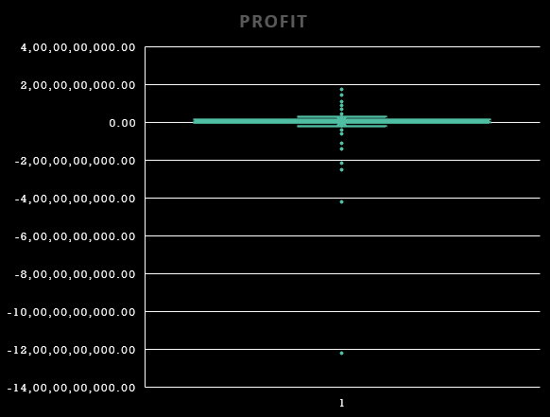
2.Profitable Movie
Using Formula the Profit was found out and Avatar is found to be the most profitable film.
Box and Whisker graph shows that The Host and Lady Vengeance with loss of -12,21,32,98,588.00 and -4,19,97,88,333.00 respectively are clearly outliers.
Extra Insights
Star wars Episode 4: A new hope is the most profitable movie
The director Joss Whedon followed by Peter Jackson, Wolfgang Peterson, George Lucas, Mark Newell are the most profitable directors
Harrison Ford followed by Scarlett Johansson, J.K Simmons, Ryan Reynolds, Robert DeNiro and Robert Downey Jr. are the most profitable actors

Slide 7
IMDB TOP 250
When all Languages are considered Shawshank Redemption is on the top with rating of 9.3 and list goes on till Ed Wood with rating 7.9.
When the English language is deselected then top film is The Good the Bad and the Ugly with IMDB rating of 8.9 and goes on till In the land of blood and Honey with rating of 4.3, it should be noted only 180 films of foreign language were in the database hence there are the top 180 and not the top 250.
(data set too large to fit in the ppt)

Slide 8
Top Directors
Some Insights
Crime,drama,comedy,action,adventure and thriller are the top genre of which these director direct movies
Interestingly profitability and high IMDb rating has a negative corelation of -0.284640806
This is seen when only Alfred Hitchcock, Damien Chazelle, Majid Mjijdi, Christohper Nolan, Richard Marquand and Asghar Farhadi being profitable and not the others
Ddirector | Average of imdb_score
Tony Kaye | 8.6
Charles Chaplin | 8.6
Alfred Hitchcock | 8.5
Ron Fricke | 8.5
Damien Chazelle | 8.5
Majid Majidi | 8.5
Sergio Leone | 8.433333333
Christopher Nolan | 8.425
S.S. Rajamouli | 8.4
Richard Marquand | 8.4
Marius A. Markevicius | 8.4
Asghar Farhadi | 8.4

Slide 9
Top GENRES
Formula Used
=COUNTIF(Table3[genres],"*"&T4&"*")
=AVERAGEIF(IMDB_Movies!$D$2:$D$3888,"*"&S4&"*",$N$2:$N$3853)
=AVERAGEIF(IMDB_Movies!$D$2:$D$3888,"*"&S4&"*",$O$2:$O$3853)
Genre | Count | Average IMDB | Profitability Average
Drama | 1944 | 6.784877 | 10047152.49
Comedy | 1503 | 6.184498 | -3156373.362
Thriller | 1117 | 6.378066 | 12282848.4
Action | 962 | 6.290748 | -563578.7921
Romance | 879 | 6.426962 | 8760736.422
Adventure | 787 | 6.458323 | -1760592.976
Sci-Fi | 497 | 6.322736 | 8937480.734
Horror | 391 | 5.926087 | 30581085.51
Documentary | 64 | 6.99375 | 8000785.969
Western | 60 | 6.756667 | 12617638.02
Insights
Drama followed by comedy and Thrilller are the top Genres
Though Depending upon the IMDB ratings, Documentary then Drama and then western are the top genres
In terms of Profitability, Horror has the highest profitability despite having low count and low IMDb followed by western then thriller.
Interestingly genres like comedy, action, adventure which has relatively higher IMDb rating average makes loss.
Horror genre though with highest profitability has the lowest IMDB rating average

Slide 10
Critic review and audience review
According to average of users and critic reviews Johnny Depp is the favourite.
According to only User Reviews Heather Donahue is the favourite.
According to Critic Review Albery Finney is the favourite.
Extra Insights
Out of all these actors only Christo Jivkov all other are profitable actors
Actor Names | Average of num_user+critic for reviews
Johnny Depp | 16196
Leonardo DiCaprio | 13069
Christian Bale | 11618.5
Actor Names | Average of num_user_for_reviews
Heather Donahue | 3400
Christo Jivkov | 2814
Steve Bastoni | 2789
Actor Names | Average of num_critic_for_reviews
Albert Finney | 750
Phaldut Sharma | 738
Peter Capaldi | 654

Slide 11
Decade wise change in voting

Slide 12
RESULT
The given project helped me gain mastery in pivot tables, formulas and functions.
This helped in establishing an advance understanding for MS Excel.

